Slide 1


Fabrizio De Castelli
Andrea Cardia

Slide 2
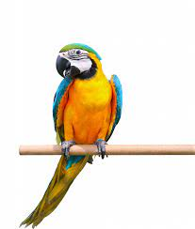
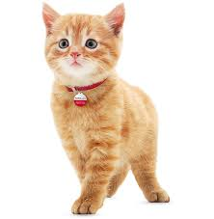
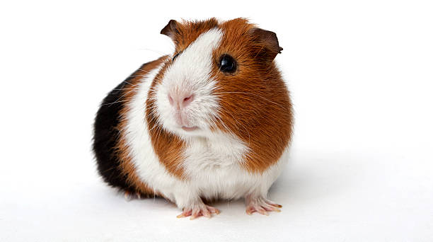

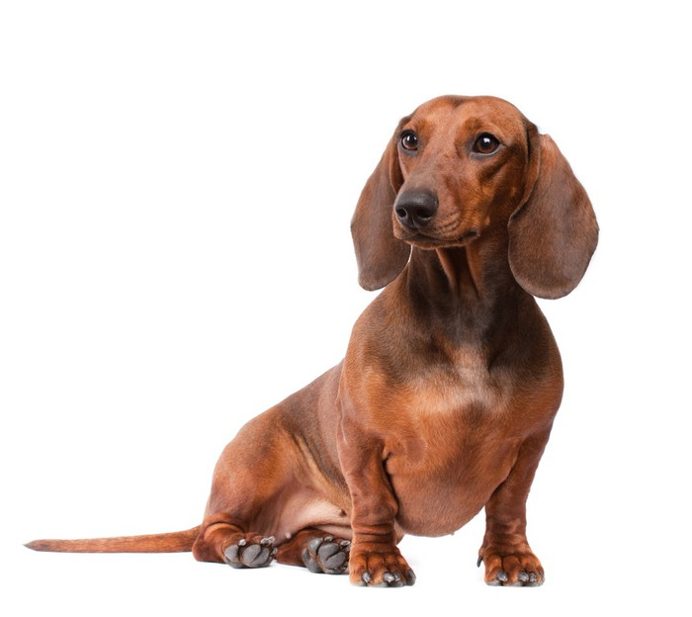


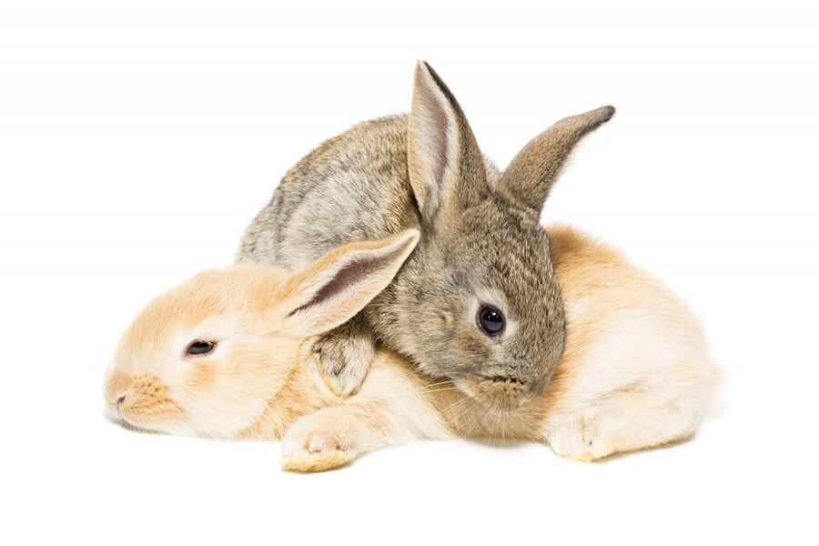

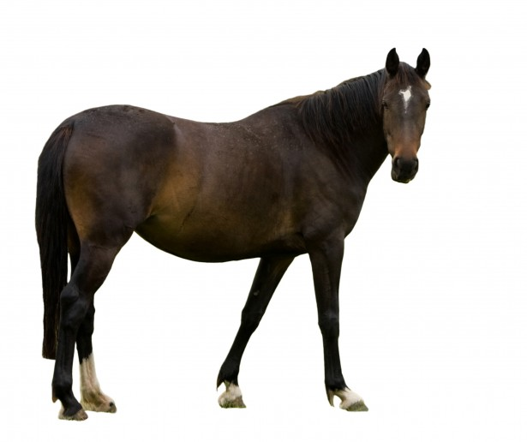

Crawling

Slide 3

Implemented Features
☼ Results presentation
☼ Automatic Recommendation

Slide 4

Web Interface
Design with:
☼ html
☼ jinja2
☼ Flask

Slide 5

Demo

